Slide 1
CSE 5330
Project Presentation
Team 4
Pranav Reddy Gudipati Maharshi Chiragkumar Shah
Sriman Goud Emagouda
Subhash Radhakrishnan

Slide 2
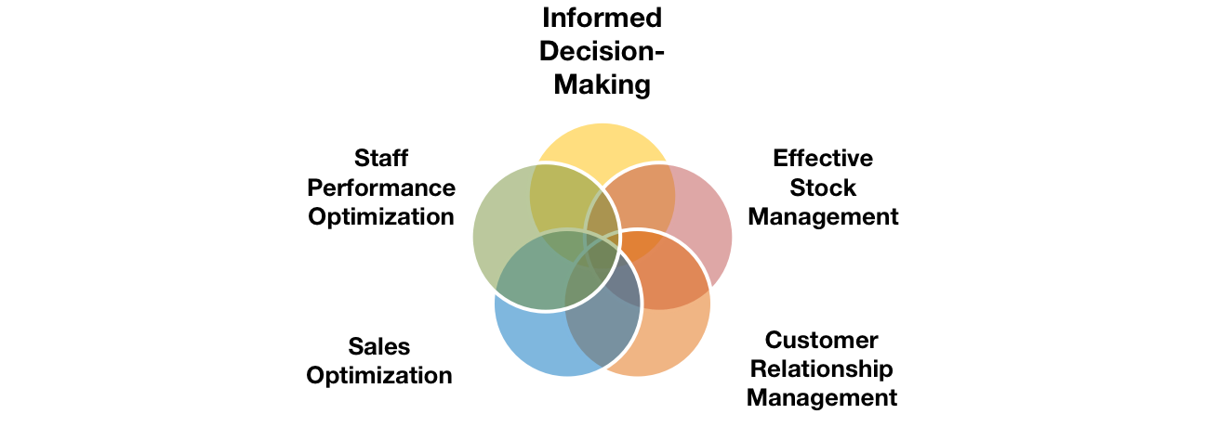
Project
Mobile Phone Retail Company Database:
Domain: Retail and Sales Management
Our project, the Mobile Phone Retail Company Database Management System, addresses the needs of business owners in the mobile phone retail industry. It provides a comprehensive solution to manage information about products, staff, promotions, customers, and purchases. With a focus on five prominent brands and their respective models, the system aims to streamline operations, optimize stock management, and enhance sales through informed decision-making.

Slide 3
Project
How will this project be helpful if deployed in the real world?
Business Goal 1: Identify Underperforming Phones
Significance: Enables the business to pinpoint phones with lower sales during specific periods.
Real-World Application: Facilitates targeted marketing or promotions to boost sales for underperforming models, optimizing inventory.
Business Goal 2: Analyze Monthly Purchase Trends
Significance: Provides insights into customer behavior by analyzing monthly purchase patterns.
Real-World Application: Helps in tailoring marketing strategies, stock levels, and promotions based on historical purchase trends.

Slide 4
Project
Business Goal 3: Forecast Demand and Manage Inventory
Significance: Allows forecasting demand and managing inventory based on historical sales data.
Real-World Application: Enhances inventory planning, ensuring adequate stock levels to meet customer demand.
Business Goal 4: Identify Customers Buying all models of a specific brand.
Significance: Identifies loyal customers purchasing all models of a specific brand.
Real-World Application: Enables targeted promotions and exclusive offers for customers promoting brand loyalty.

Slide 5
Project
Business Goal 5: Maintain Customer Records for Targeted Promotions
Significance: Helps in tracking customer preferences for personalized promotions.
Real-World Application: Facilitates targeted marketing by promoting new products from preferred brands, increasing customer engagement.
Business Goal 6: Sales Performance Incentives
Significance: Calculates incentives based on staff performance, encouraging higher sales.
Real-World Application: Motivates staff to achieve higher sales figures, contributing to business growth.

Slide 6
Project
Business Goal 7: Evaluate Staff Performance
Significance: Identifies staff with average customer ratings below 3.5 for performance evaluation.
Real-World Application: Guides training and improvement strategies to enhance overall customer satisfaction.
Business Goal 8: Analyze Payment Method Distribution
Significance: Identifies the most used payment method for potential discount opportunities.
Real-World Application: Helps in collaboration with specific banks for exclusive discounts, potentially boosting sales.

Slide 7
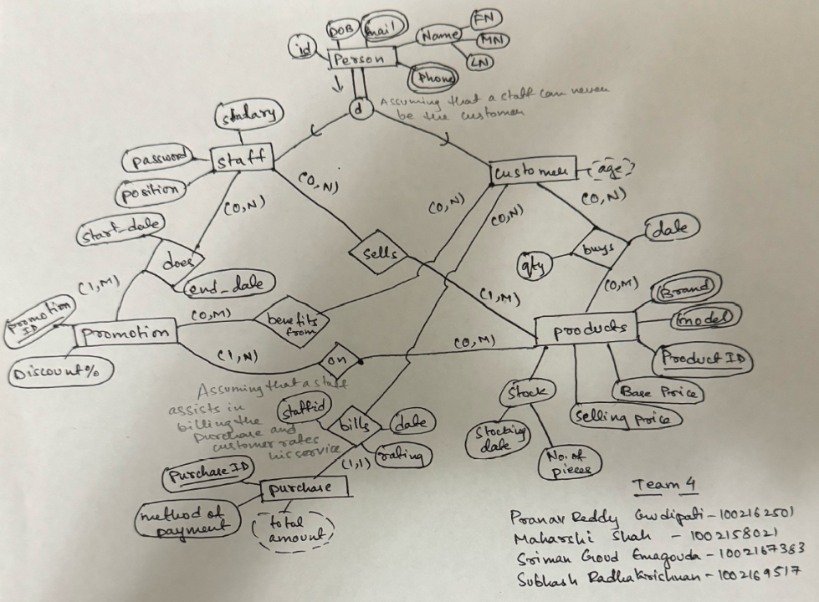
Project Overview
EER diagram

Slide 8
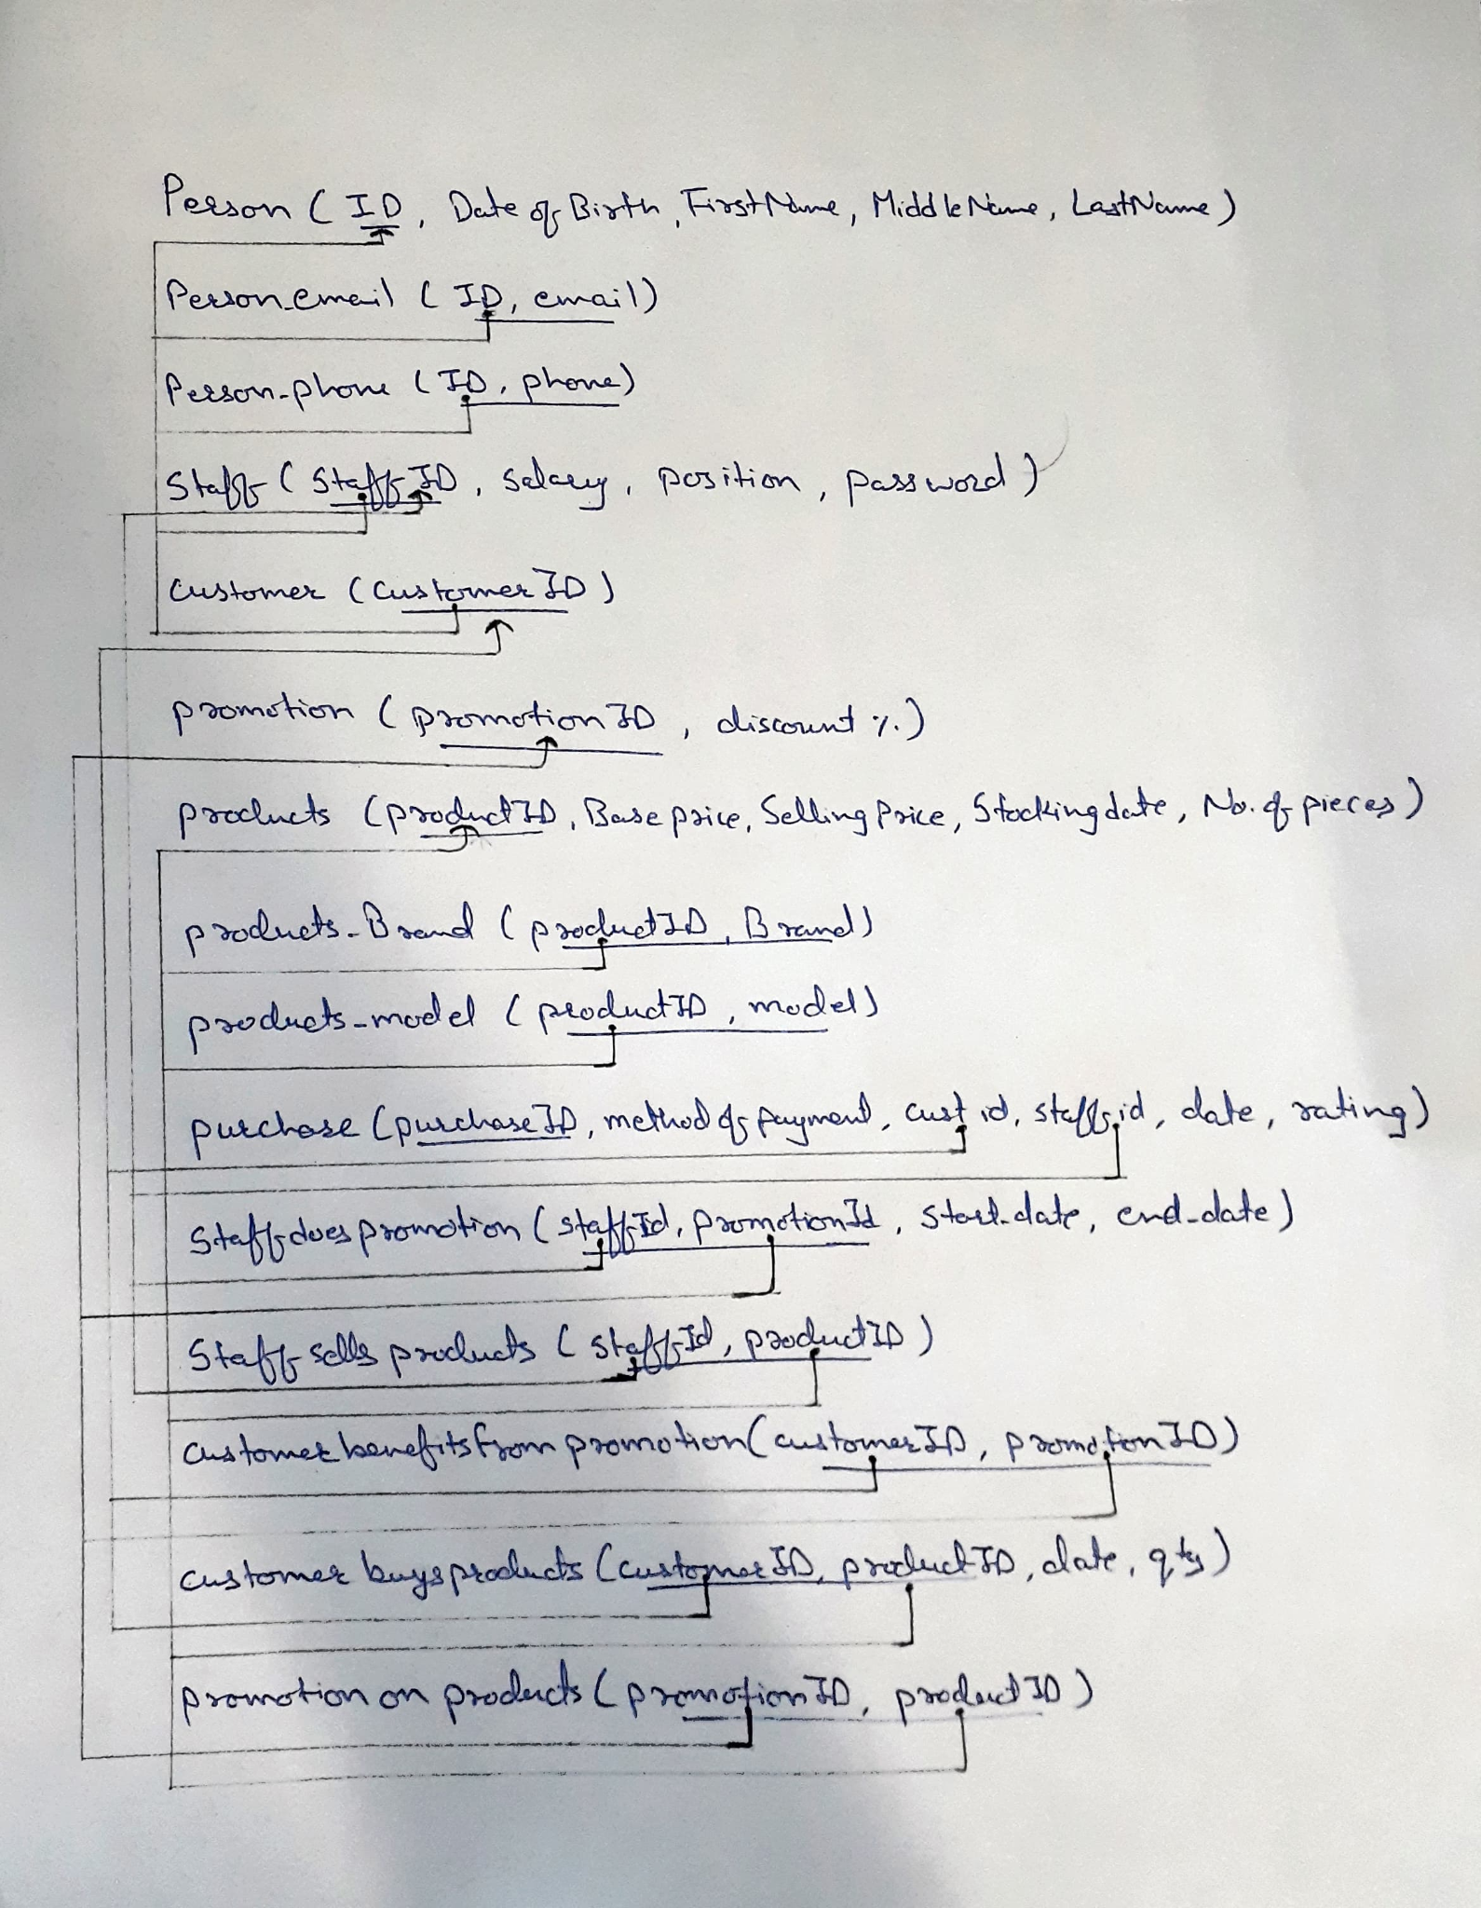
Project Overview
The relational schema

Slide 9
Project Overview
F23_S002_T4_person: 200 rows
F23_S002_T4_person_email: 200 rows
F23_S002_T4_person_phone: 200 rows
F23_S002_T4_staff: 100 rows
F23_S002_T4_customer: 100 rows
F23_S002_T4_promotion: 50 rows
F23_S002_T4_products: 30 rows
F23_S002_T4_products_brand: 30 rows
F23_S002_T4_products_model: 30 rows
F23_S002_T4_purchase: 50 rows
F23_S002_T4_staffdoespromotion: 50 rows
F23_S002_T4_staffsellsproducts: 300 rows
F23_S002_T4_customerbenefitsfrompromotion: 50 rows
F23_S002_T4_customerbuysproducts: 56 rows
F23_S002_T4_promotiononproducts: 50 rows
There are a total of 15 tables created and 1,046 rows have been inserted across all tables.

Slide 10
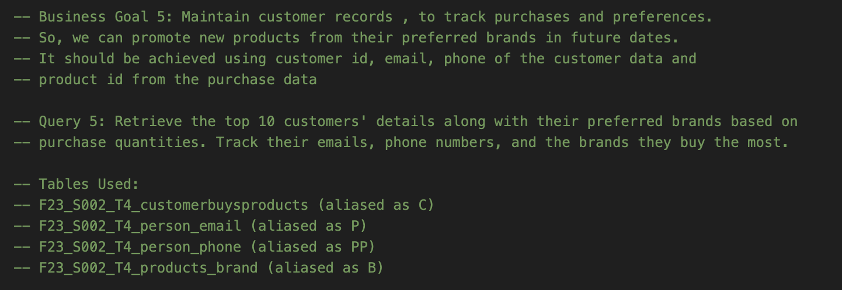
Project Goal
We, successfully met all our business goals!
Here are 2 queries , that we thought were interesting to present :

Slide 11
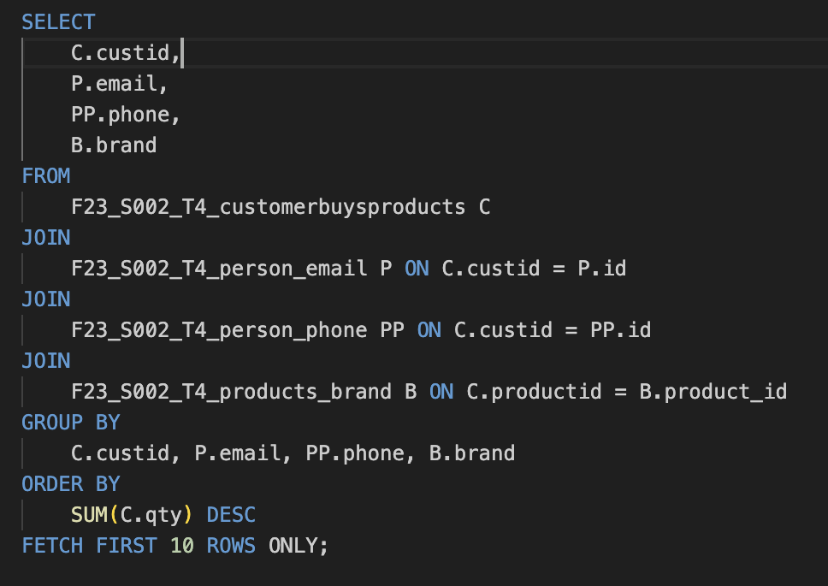
Project Goal

Slide 12
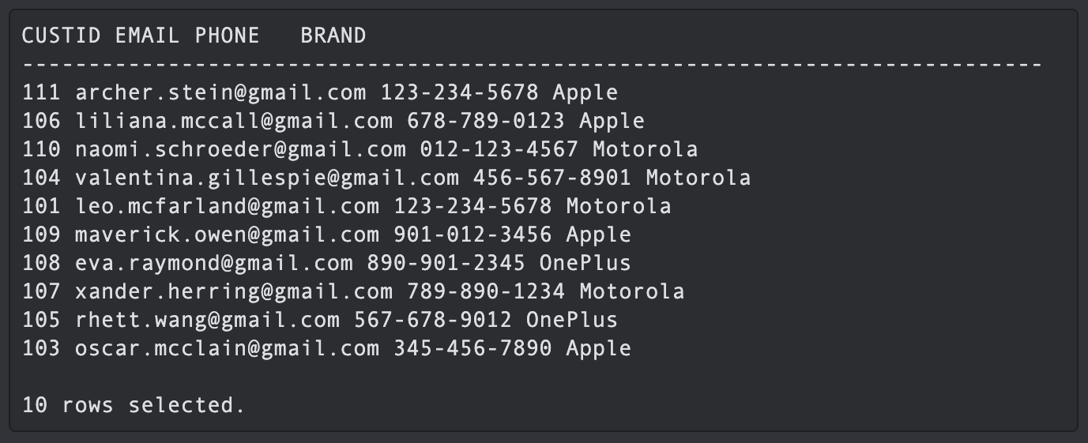
Project Goal

Slide 13
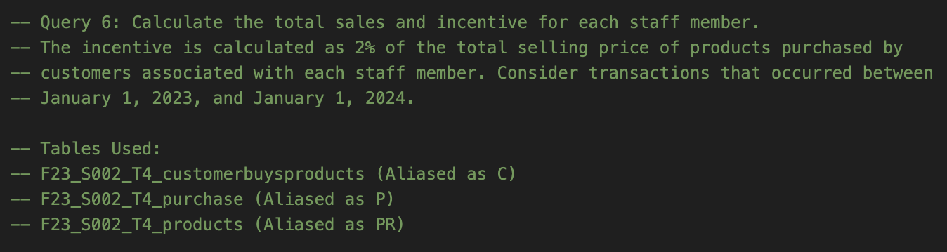
Project Goal

Slide 14
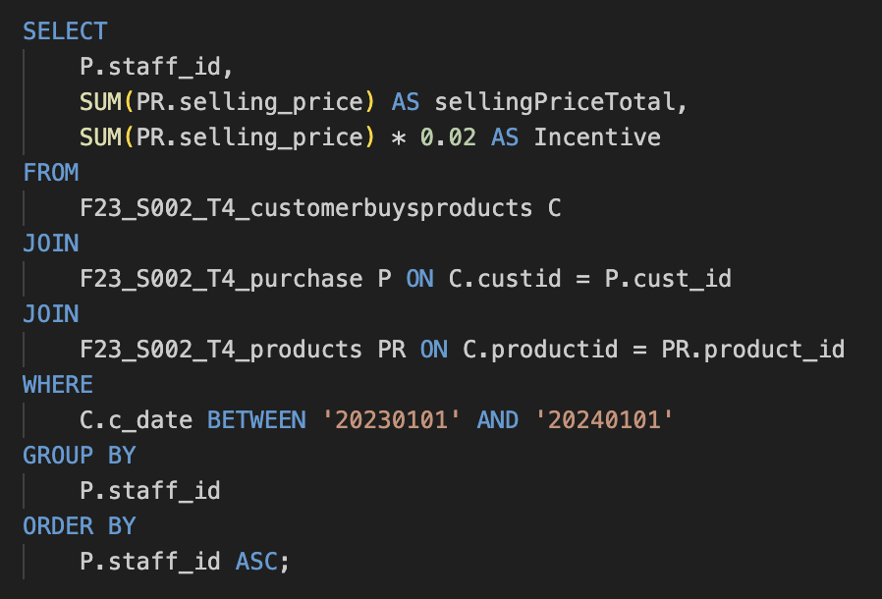
Project Goal

Slide 15
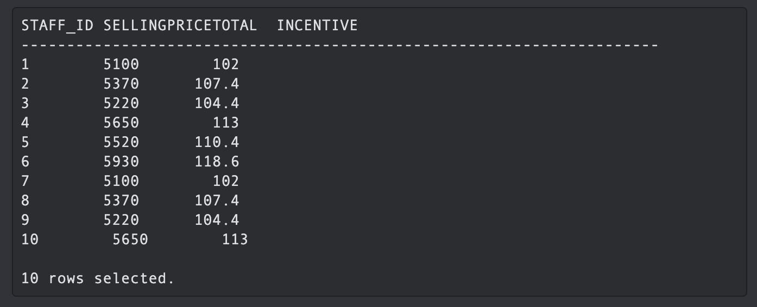
Project Goal

Slide 16
Project Lookback
How did we break down the phases into sub-tasks and manage time?
We adopted an iterative approach to breaking down phases into sub-tasks. Initially, each team member proposed their own version for each phase. We then engaged in a collaborative discussion, critically evaluating and correcting each version. Through this iterative process, we converged on a final draft that we collectively submitted for each phase. This method allowed us to benefit from diverse perspectives and refine our ideas effectively.
In terms of time management, we established clear timelines for each phase and regularly assessed our progress. By setting milestones and deadlines, we ensured that tasks were completed in a timely manner. Additionally, constant communication within the team played a crucial role in coordinating efforts and addressing any challenges promptly.

Slide 17
Project Lookback
Which phase of the project was difficult and why?
The first phase, where we had to conceptualize ideas, plan requirements, and settle on a cohesive direction, was particularly challenging. This phase demanded extensive brainstorming and analysis. Choosing the most suitable approach among various ideas required careful consideration of project goals and feasibility. Moreover, defining precise requirements was essential for setting the project on a solid foundation. The complexity of this initial decision-making process made it the most demanding phase.

Slide 18
Project Lookback
If you are asked to redo this project, what would we change in the approach we followed?
In a redo, we would focus on refining our approach to time management. While our initial strategy was effective, there's always room for improvement. We would emphasize setting even more realistic timelines for each sub-task, considering potential challenges and allowing for more flexibility in our schedule.

Slide 19
Project Takeaway
We are content with the development achieved in this project, as it provided valuable hands-on experience and enhanced our skills.
The project's successful completion showcases practical application of our abilities and adds a meaningful entry to our resume
The ability to break down complex problems, collaborate within a team, and manage time effectively were key takeaways.
These skills will undoubtedly prove beneficial in future endeavors, contributing to our professional growth and adaptability in diverse work environments.

Slide 20

Discussion

